Slide 1
Personalized Instruction of Physical Skills with a Social Robot
Alexandru Litoiu
alex.litoiu@yale.edu
Social Robotics Lab
Yale University

Slide 2
Social Robotics Lab
Alexandru Litoiu
3rd year PhD Candidate
Social Robotics Lab, Yale University
Interested in building robots that can coach physical tasks
Started project a couple of months ago
Canadian!

Slide 3
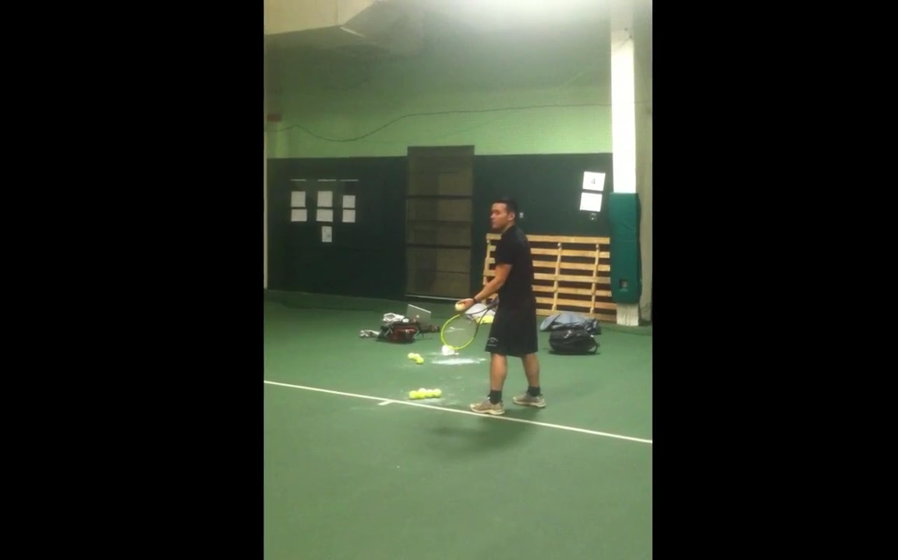
A Novice Tennis Serve

Slide 4
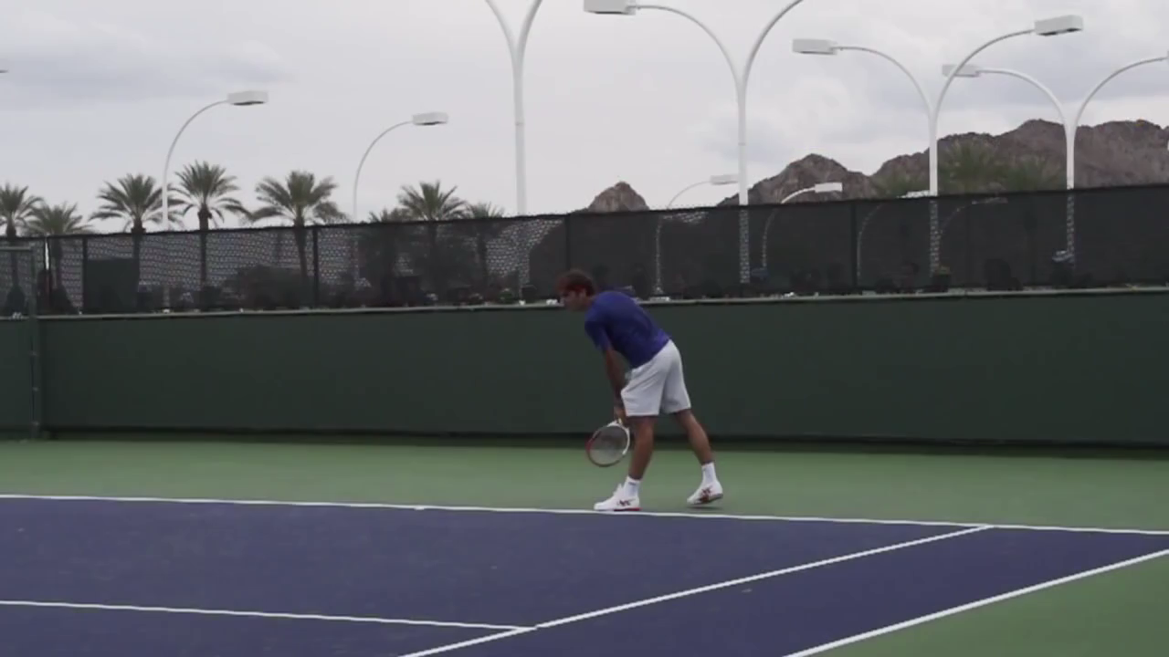
An Expert Tennis Serve

Slide 5

An Expert Tennis Serve – Slow Motion

Slide 6
Socially Assistive Robots for Coaching Physical Tasks
How do we deliver advice to effectively induce a transformation from incorrect human movements into correct human movements?
Help children to become more physically proficient
Children that are more physically proficient are more likely to be more physically active [1] [2]
Assist rehabilitation patients to perform complex motor tasks
[1] Wrotniak, Brian H., et al. "The relationship between motor proficiency and physical activity in children." Pediatrics 118.6 (2006): e1758-e1765.
[2] Barnett, Lisa M., et al. "Childhood motor skill proficiency as a predictor of adolescent physical activity." Journal of Adolescent Health 44.3 (2009): 252-259.
Notes:
Vision

Slide 7
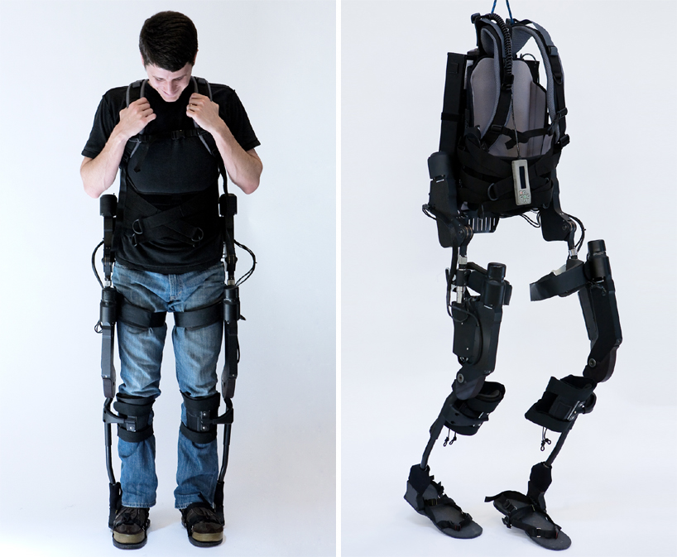
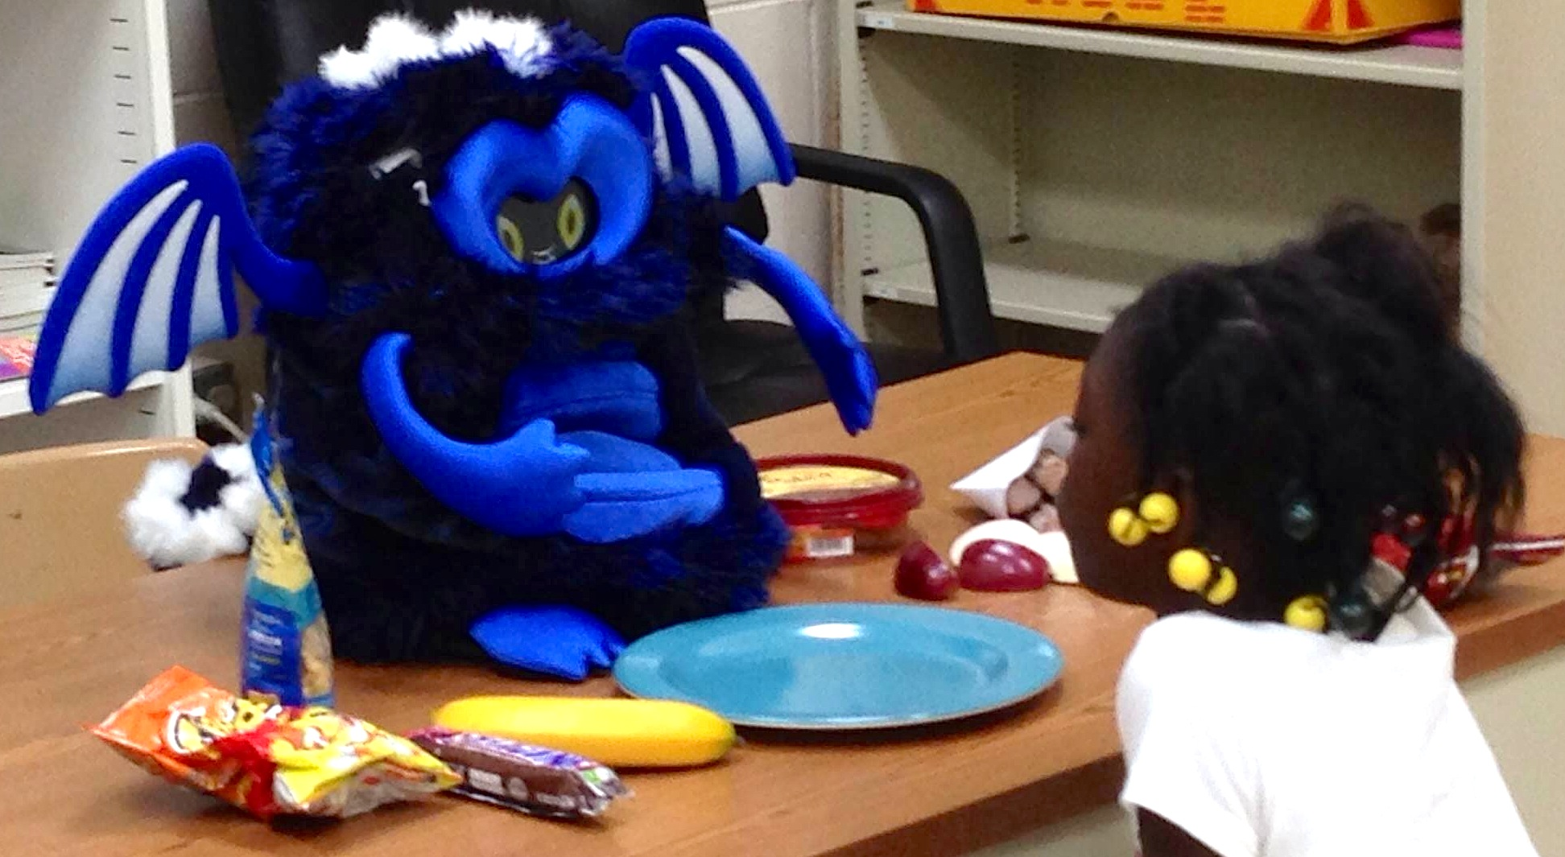
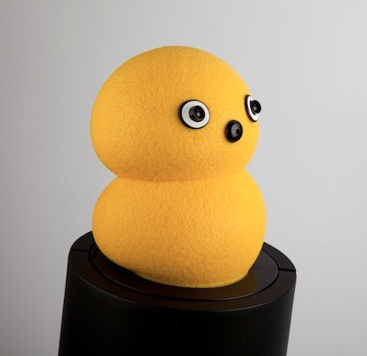
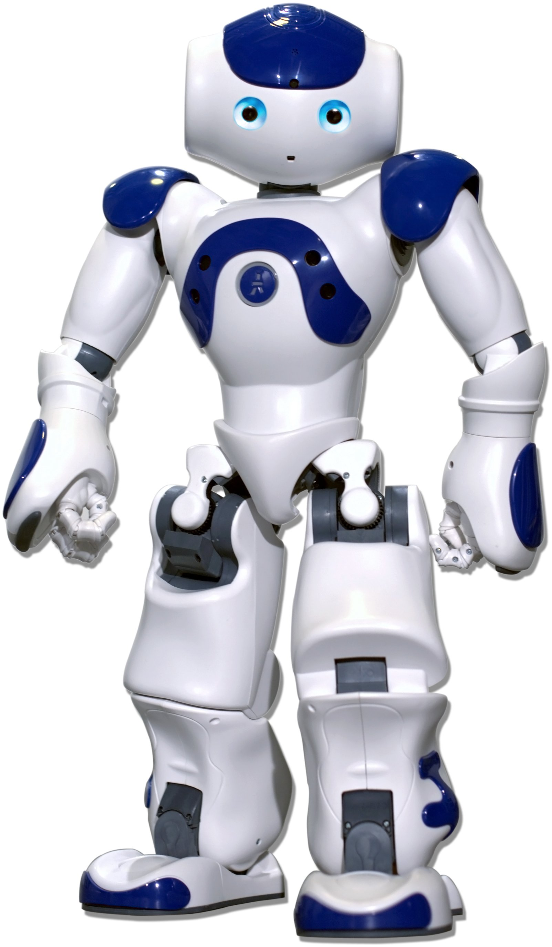
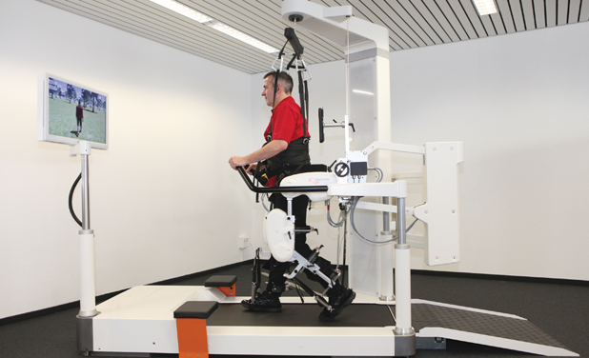
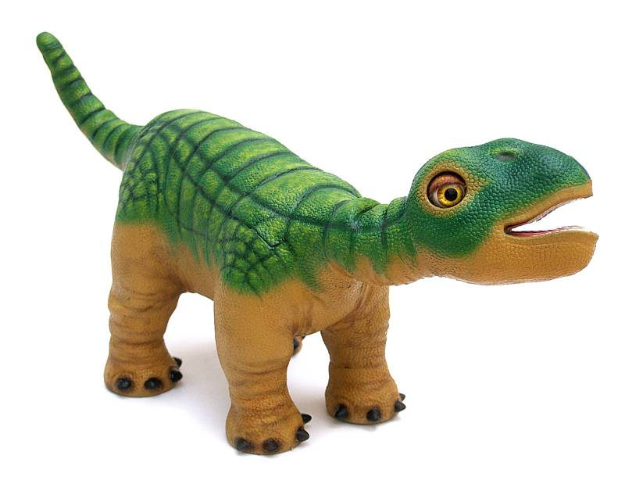
Robotic Orthoses
Socially Assistive Robots

Slide 8
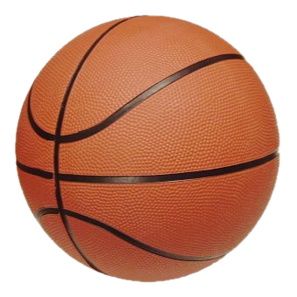
Application Domain : Teaching Children to Shoot a Basketball
Reliable supervisory signal
Clear score/no score
Simplified perception
Free throw from same spot – perception system stationary
Automated Coachability
Repetitive motion enables system to learn and give recommendations
Ball in hand – do not need to change motion based on a pitch, i.e. baseball

Slide 9
Experimental Setup

Slide 10
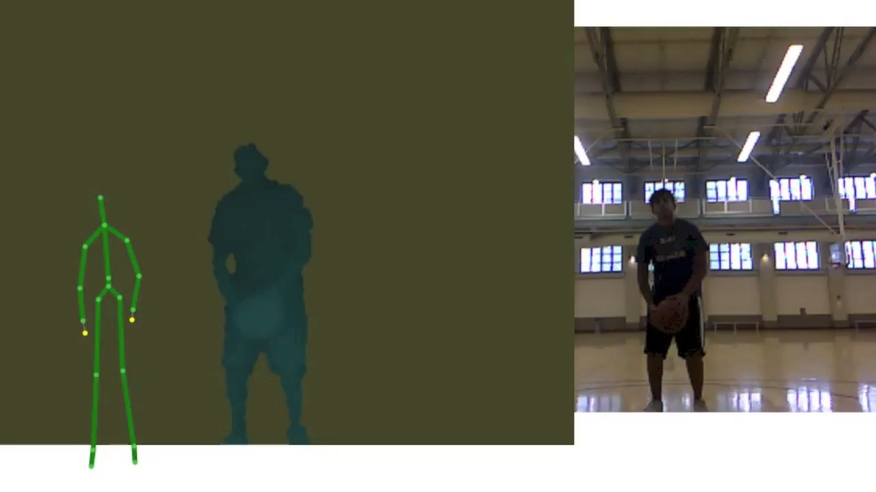
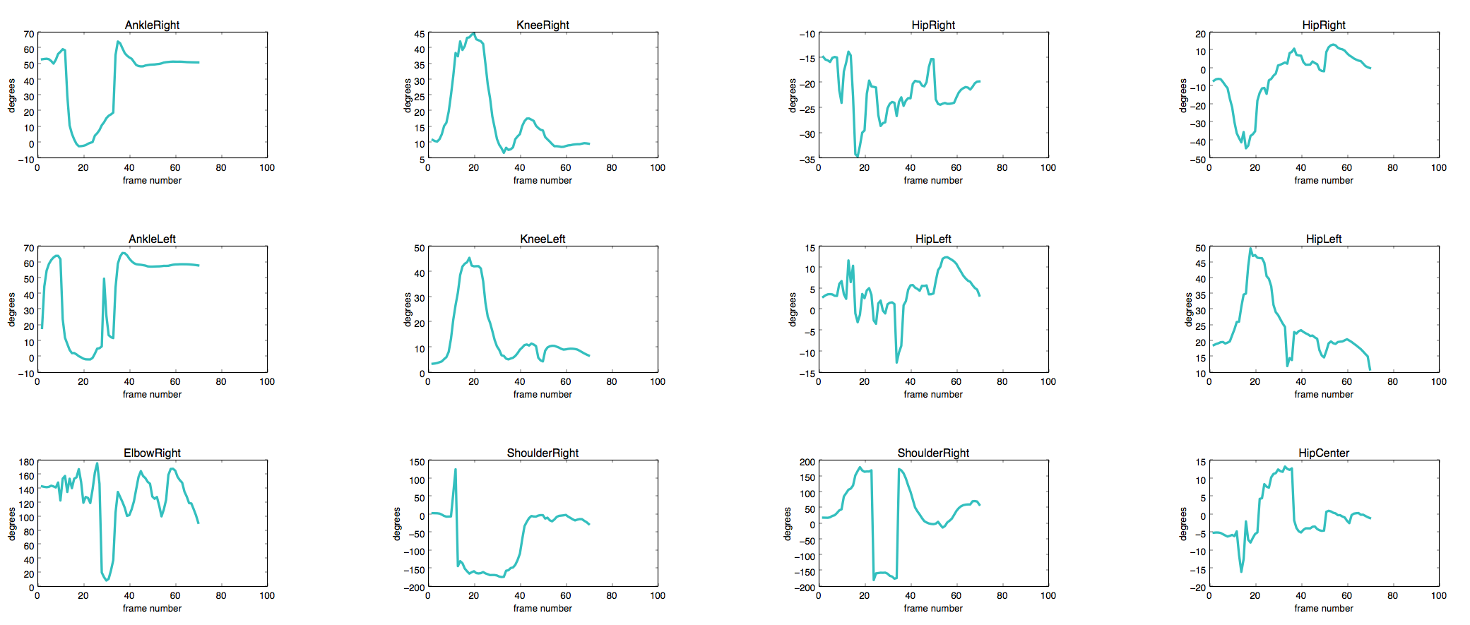
Perception of Joint Angle Time Series Using Kinect

Slide 11
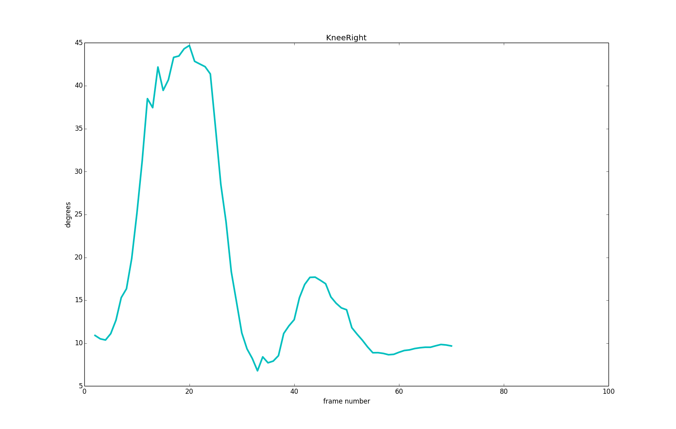
Right Knee Time Series

Slide 12
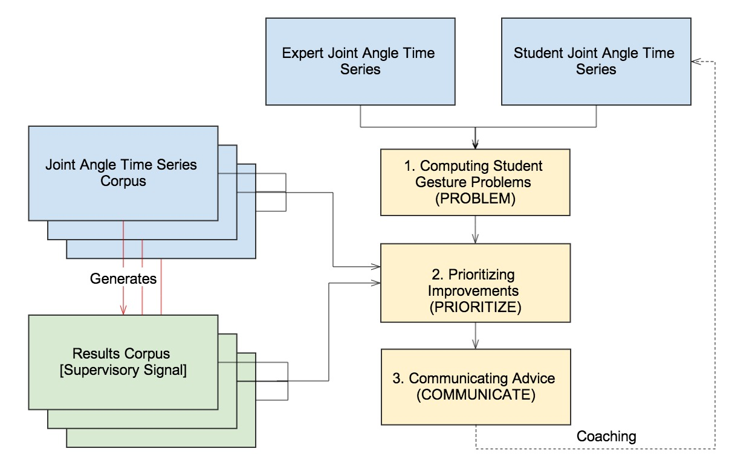
A First Pass Approach For Physical Skills with Supervisory Signals
Converge your shot to a reference trajectory
Understand the participant and be useful, as quickly as possible

Slide 13
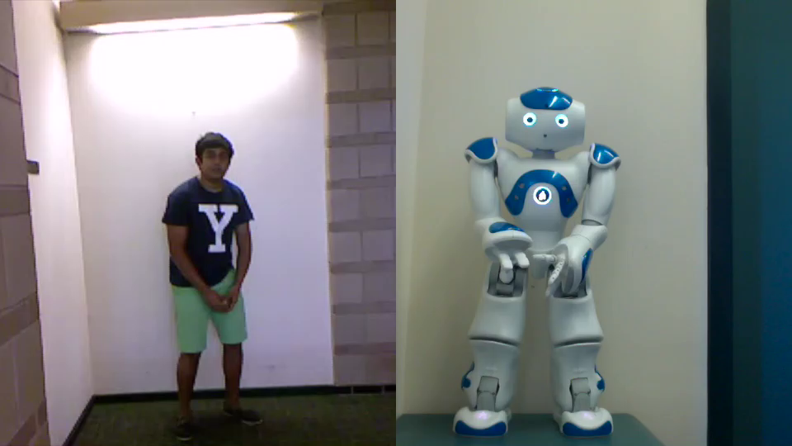
Communicating Advice – Demonstrations

Slide 14
Summary
How do we deliver advice to effectively induce a transformation from incorrect human movements into correct human movements?
Help children to become more active
Help rehabilitate recovering stroke and spinal cord injury patients
Started creating a system to coach supervised motions such as basketball
Created a PROBLEM module
Collected data for and investigating machine learning approaches for PRIORITIZE
In advanced stages of creating demonstration COMMUNICATION module
Thank You

